Slide 1
Scrum Artifacts

Slide 2
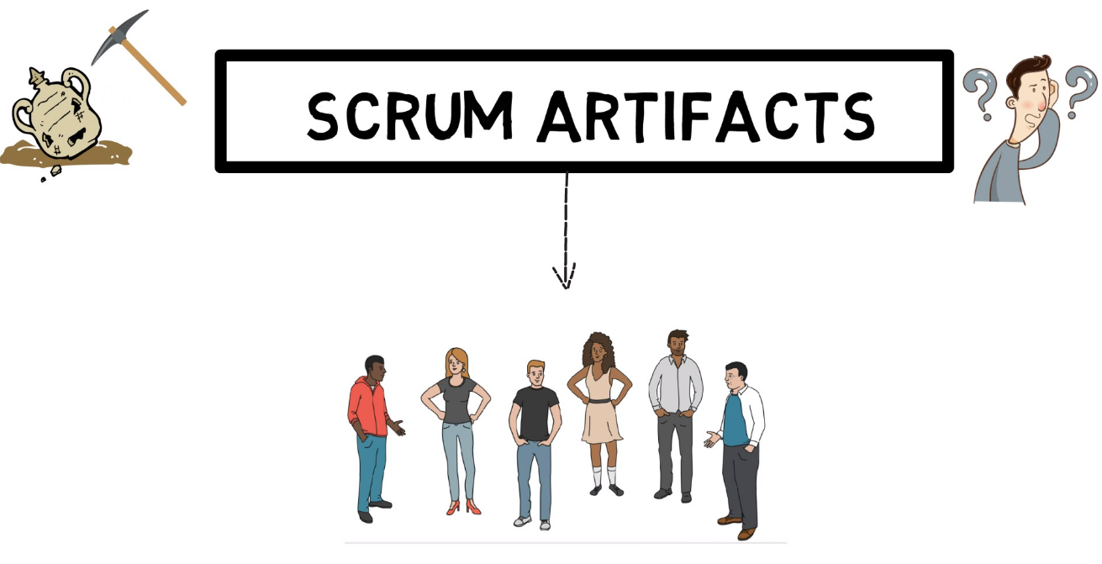
In scrum, an artifact is something that is created by the ones using scrum.

Slide 3
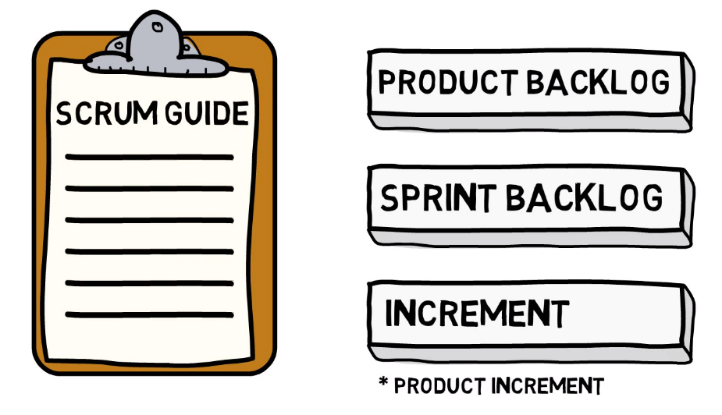



Artifacts

Slide 4
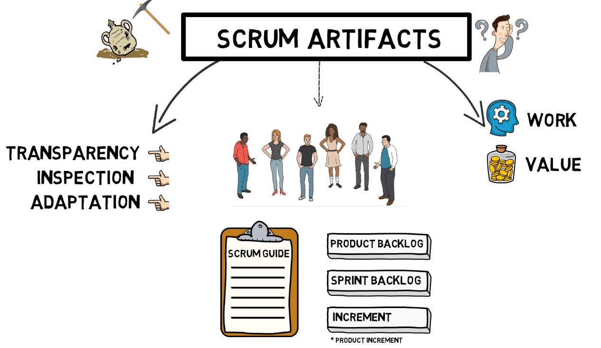
Artifacts
Artifacts in scrum represent Work or Value.
They provide Transparency and opportunities for Inspection and Adaptation.

Slide 5
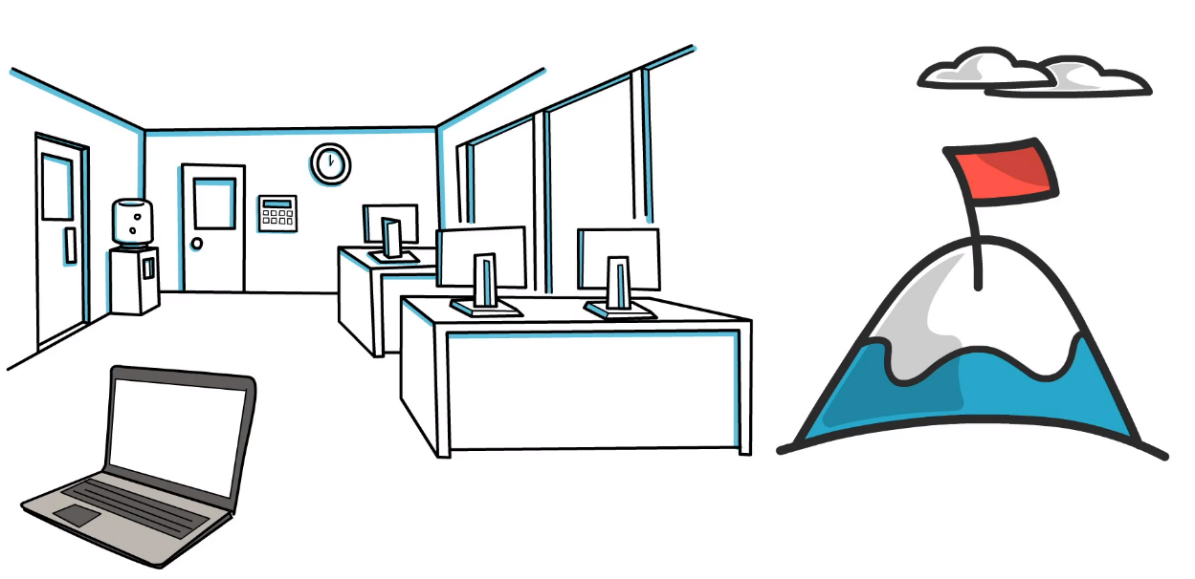
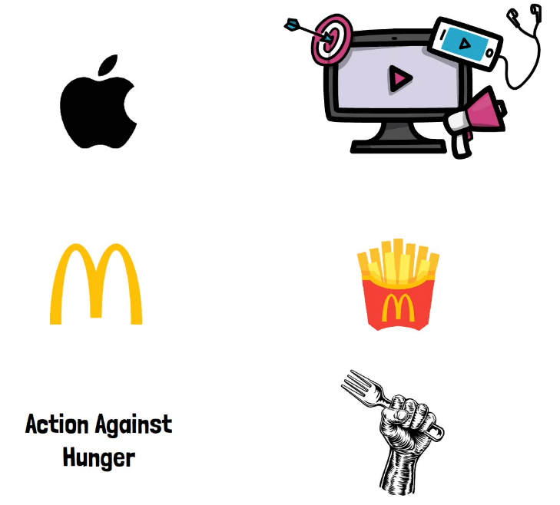
Organization Goal
Products that are developed by the organization is mainly the organization Goal for scrum.
Apple wants to make the best products on Earth.
McDonald's wants to be the best quick service restaurant experience.
Action Against Hunger is committed to ending world hunger.

Slide 6
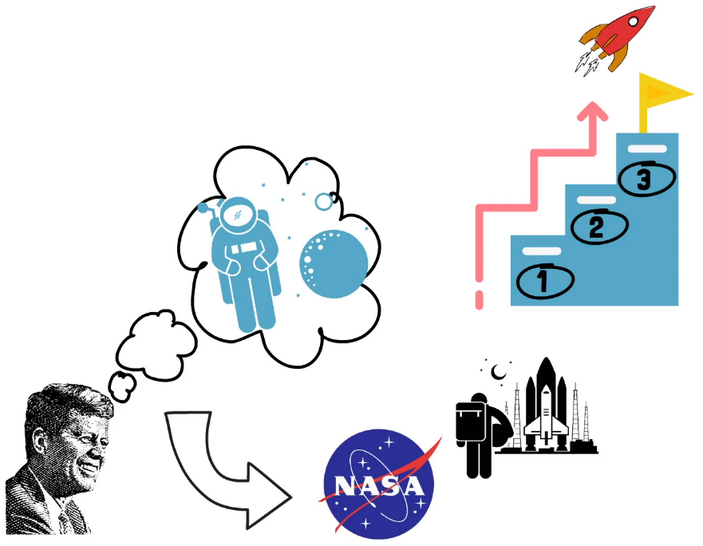
Organization Goal
You can call this a vision, or an ambitious goal, but Kennedy’s vision was to land a man on the moon and return him safely to Earth.
To reach this vision and the ultimate goal, NASA had to go through multiple milestones, or call them smaller goals if you wish.
They did not just plan one primary mission, build a rocket, push astronauts on it, start the countdown, and hope for the best.
This was the vision that guided the US Space Program in the 1960's.

Slide 7
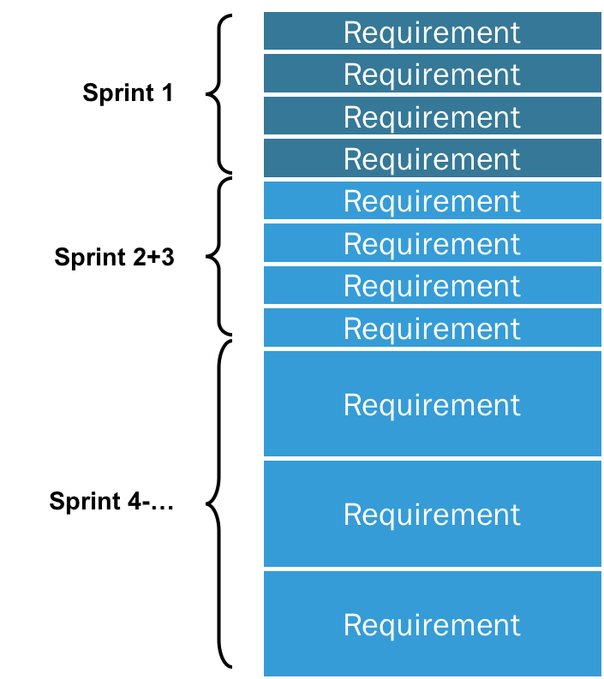
What is Backlog?
Product Backlog is simply a list of all things that needs to be done within the project. The owner of the Scrum Product Backlog is the Scrum Product Owner.
The Scrum Master, the Scrum Team and other Stakeholders contribute it to have a broad and complete To-Do list.
Generally speaking, a backlog represents an accumulation or a buildup of unfinished work. So, a product backlog contains undone things that are related to the product.

Slide 8
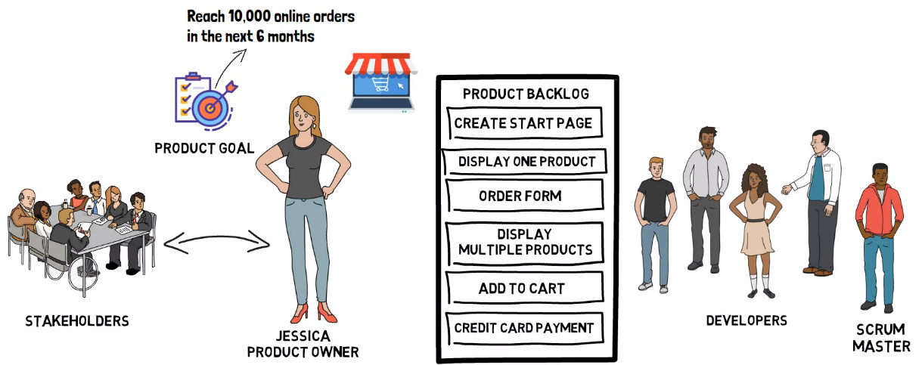
Defining the Product Goal and Product Backlog
The Product Owner is accountable for defining a Product Goal and managing the Product Backlog.

Slide 9
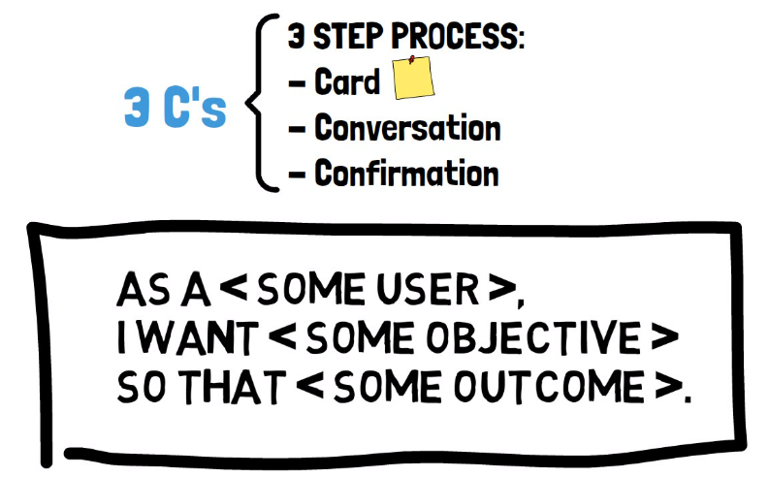
User Stories
User stories are relatively short descriptions of a feature explained from the perspective of the person who desires the functionality. Usually a user of the product.
Writing user stories, there are three-step process also known as the three C's.

Slide 10
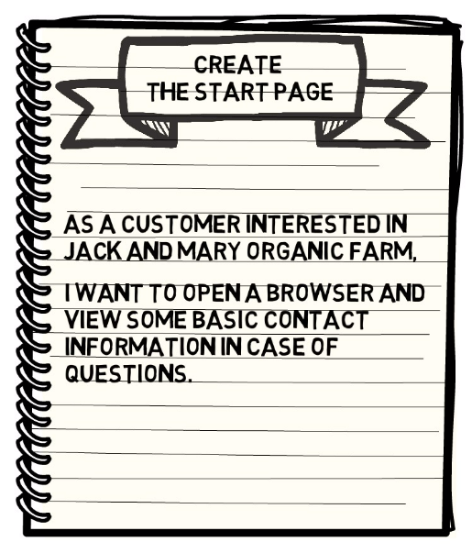

User Stories(Card): Example
Here's how the first product backlog item can be formulated as a user story. This is one way to generate user story in Scrum for a Product Backlog Item from the Product Backlog
Another way of looking at the user story format, is identifying the,
This is the first C from the three-step process.

Slide 11
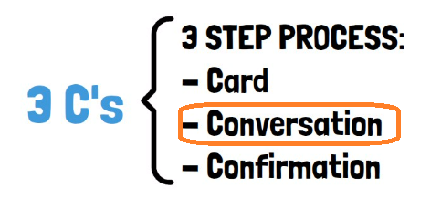
User Stories(Conversation)
We don't want to build things that have no value, and nobody wants. That’s why conversation is an important aspect and the second C.
The information contained by the product backlog item should be brief and to the point. Think of the items more like a reminder of what needs to be done.
A conversation starter.
Not necessarily detail specification. This activity helps to have the same understanding of the work to be done.

Slide 12
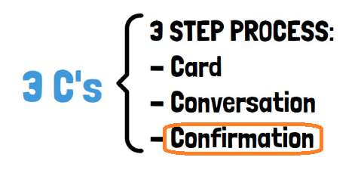
User Stories(Confirmation)
The last C is confirmation.
We commonly refer to this as acceptance criteria. It is a way to test if the story has been completed.
Acceptance Criteria

Slide 13
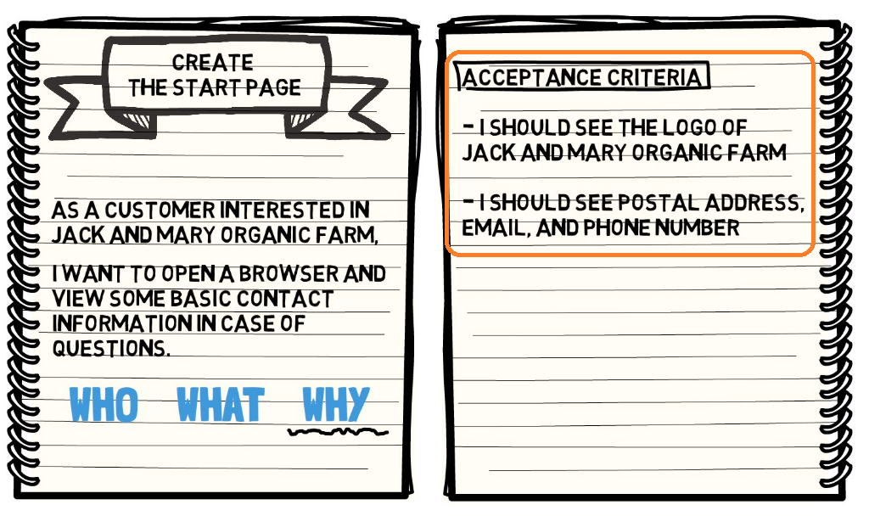
User Stories(Confirmation): Example
Let's add some acceptance criteria.
So, in this case, the product backlog item is written as a user story, but this does not mean that every item in the product backlog needs to be written using this format.
There are also other ways to do so. The Scrum team decides which format works best

Slide 14
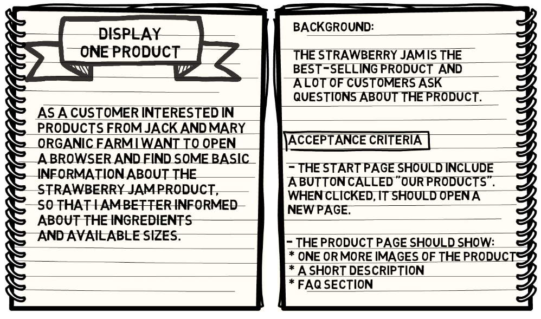
Example
So, in this case, the product backlog item is written as a user story, but this does not mean that every item in the product backlog needs to be written using this format.
There are also other ways to do so. The Scrum team decides which format works best

Slide 15
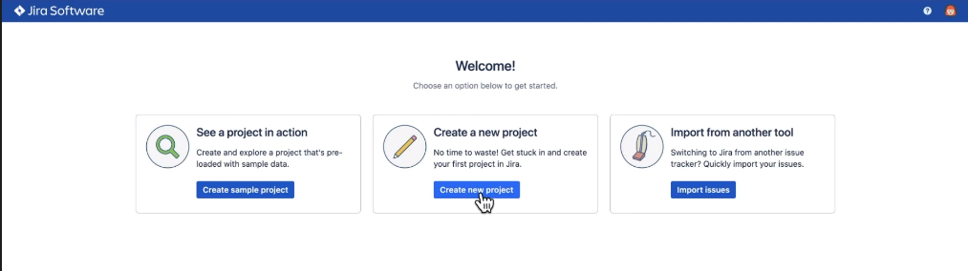
Managing the Product Backlog using Jira
Jessica, the product owner, will create a new project in JIRA.

Slide 16
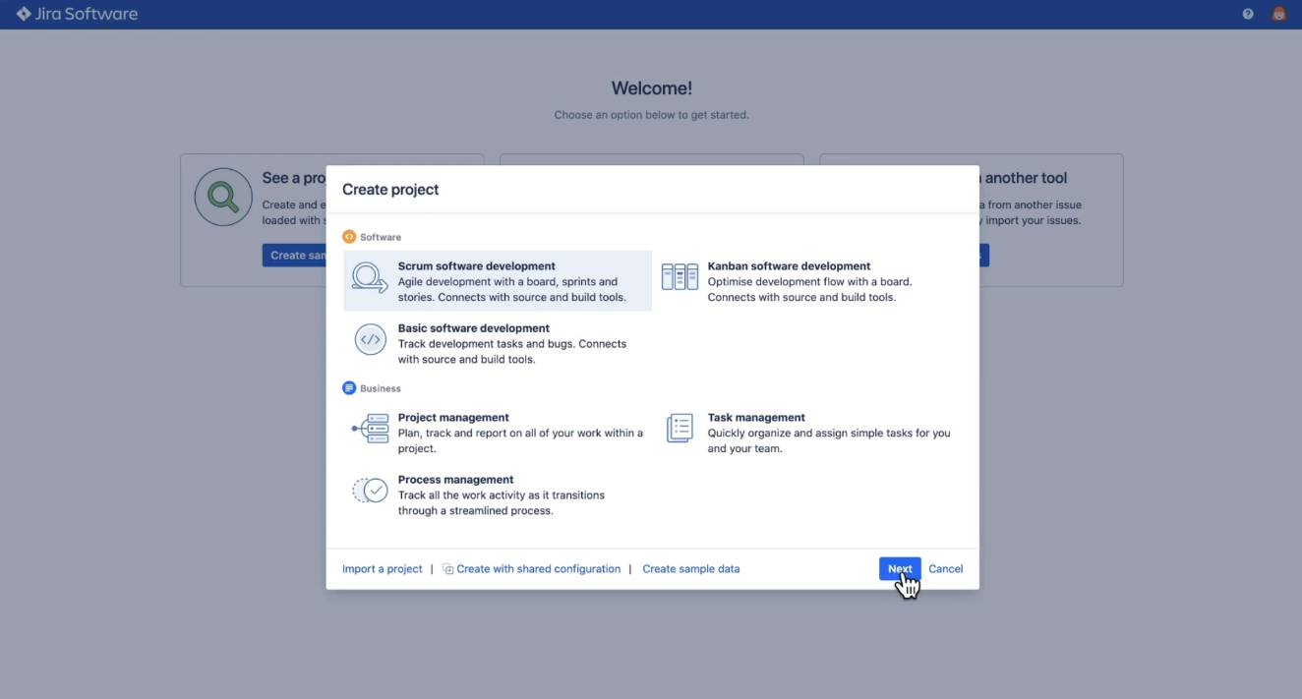
Managing the Product Backlog using Jira
Se will start adding ideas to the product backlog.

Slide 17
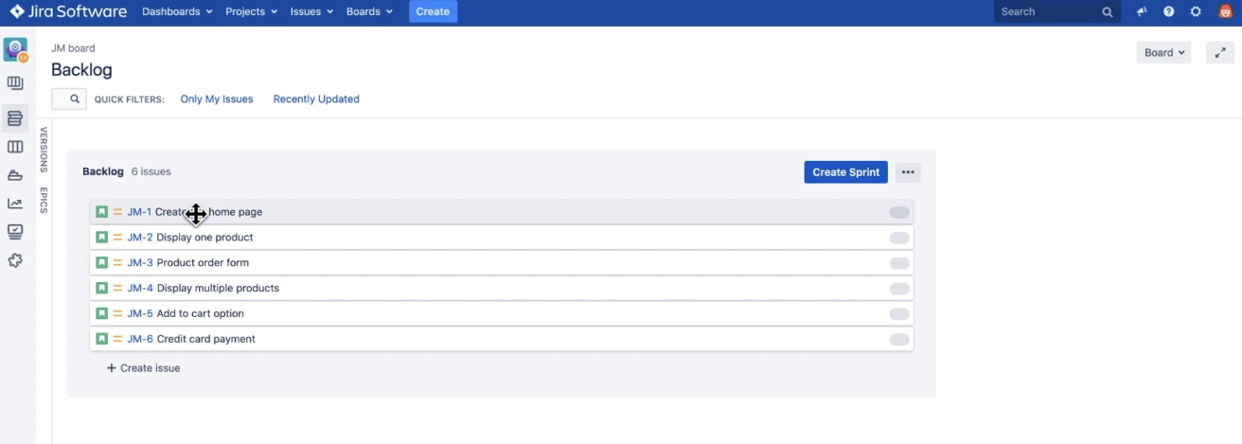
Managing the Product Backlog using Jira
She will start adding ideas to the product backlog.
Currently, the product backlog is just a simple ordered list. Each item in the list is a product backlog item. The order is given by the position of each item in the list from top to bottom.
This means that the developers will work on the items in the order decided by the product owner.

Slide 18
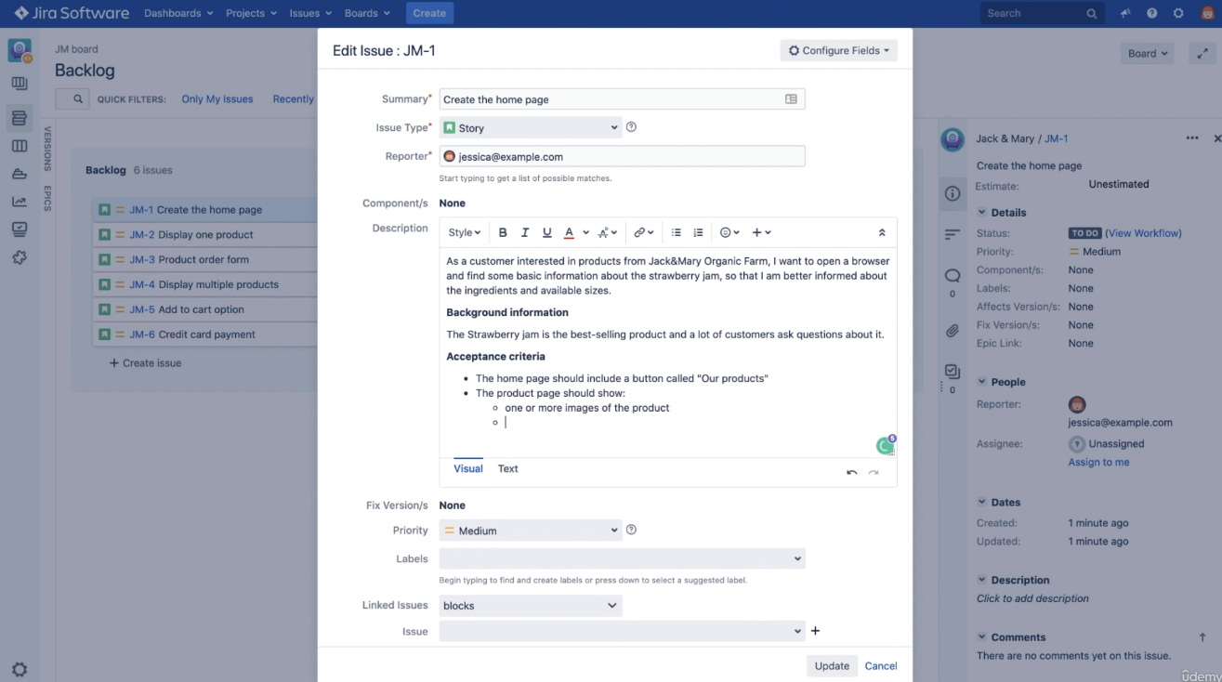
Managing the Product Backlog using Jira
The product owner can go and edit each individual item in the list to add more details to it. This product backlog item uses the user story format and will have a description.
Jessica will also add acceptance criteria to the item to make it even more clear, and the same goes for all the other items as well.

Slide 19
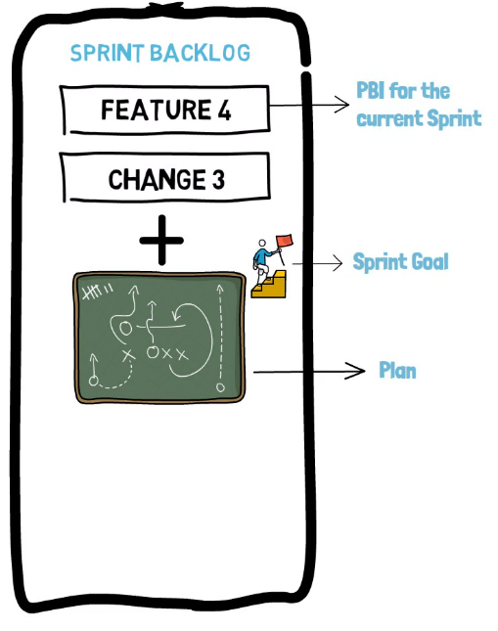
Sprint Backlog
The sprint backlog is created at the beginning of every sprint and contains the product backlog items (PBI) that will be done in the current sprint. Every sprint will have a new sprint backlog.
A plan on how to deliver the functionality and the sprint goal.
All items in the sprint backlog come from the product backlog.

Slide 20
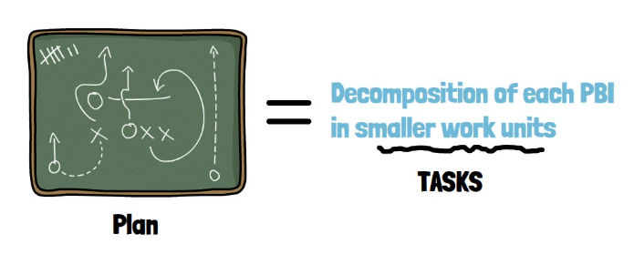
Sprint Backlog
A plan is essentially a decomposition of each product backlog item in smaller work units that allow the developers to build an increment.
In practice, we often call the smaller units of work tasks. Many people learning Scrum quite often forget that a sprint backlog also contains a plan and the sprint goal, not just the selected items.

Slide 21
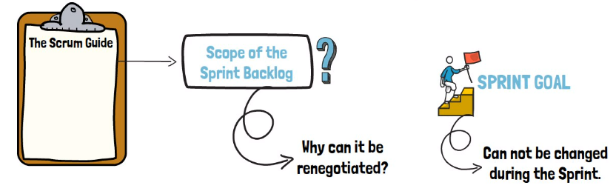
Sprint Scope vs. Sprint Goal
The Scrum Guide refers to the scope of the sprint backlog.
What is that, and why can the scope be renegotiated, but the sprint goal remains the same?

Slide 22
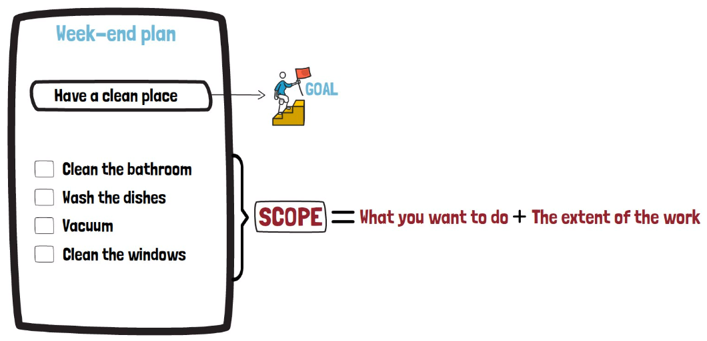
Sprint Scope vs. Sprint Goal
Remain The Same
Think about your upcoming weekend. For example, you want to clean your place on Saturday.
This is your goal; To have a clean place to live in for the next week.
The scope is the work that you want to do to reach this goal.
For Example:
So
By extent of the work, we mean while vacuuming, do you need to move the furniture, or can you keep it simple and leave the furniture as it is and vacuum in that way?
Can Change

Slide 23
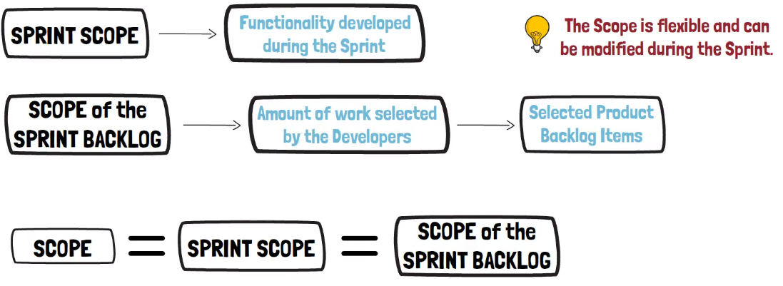
Sprint Scope vs. Sprint Goal
In Scrum, the sprint scope represents the functionality that will be developed during the sprint.
The scope of the sprint backlog is the amount of work selected by the developers.

Slide 24
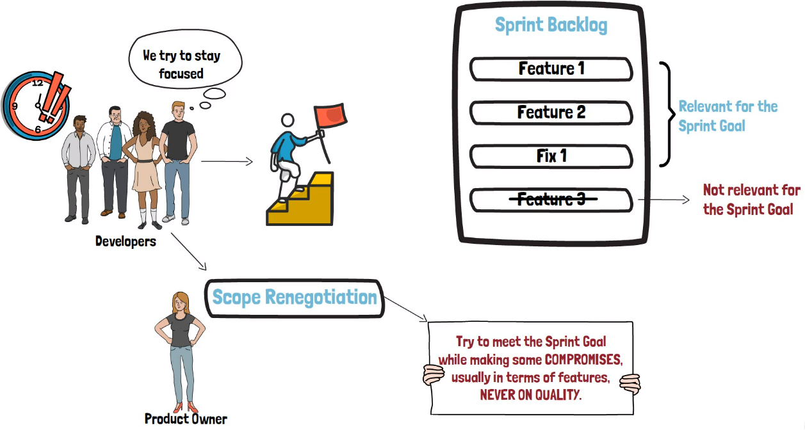
Sprint Scope vs. Sprint Goal
Scrum will not do miracles.
However, with the time available, the developers will try to stay focused and do their best to reach the sprint goal.
The scope renegotiation with the product owner can happen anytime. The idea is to meet the sprint goal while making some compromises, usually in terms of features, never on quality.
In this process, the product owner and the developers decide which is the best course of action. Some items in the sprint backlog may not directly contribute to reaching the sprint goal.
Others can be simplified. Items can even be replaced with other items from the product backlog.
Anything is possible as long as the sprint goal is not endangered.

Slide 25
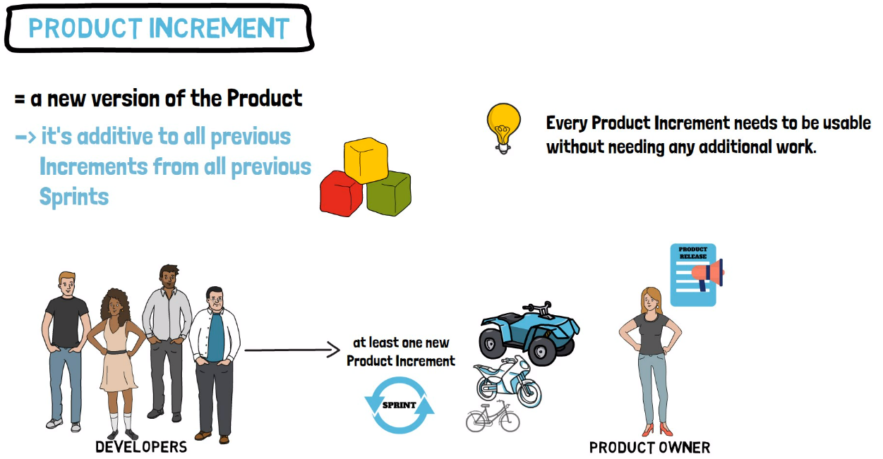
Increment & Definition of Done
You can view it like a building block placed on top of all previous work completed
The developers work to deliver at least new product increment with each sprint.

Slide 26
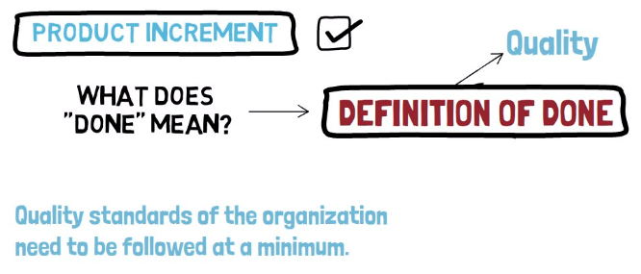
Increment & Definition of Done
When a product backlog item or increment is considered complete or done, everybody must understand what done means.
Sometimes the organization may define quality standards and those need to be followed at a minimum.
The scrum team should create a definition of done which can be used to assess if the work performed is following the agreed quality criteria.
Try to remember that the definition of done is mostly about quality.

Slide 27
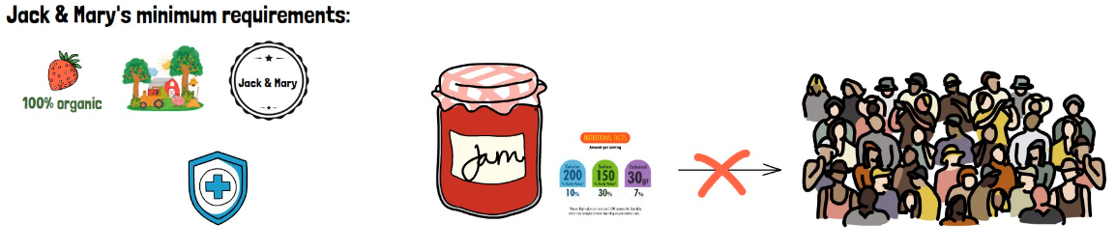
Increment & Definition of Done: Example
Let's assume Jack and Mary would define some minimum requirements for any of their products.
For example, contains only organic ingredients.
Raw materials come from small independent farms.
The logo of Jack and Mary must be visible on the product.
The product label must indicate the number of calories, sugar contents, and so on.
Conforms with health and safety standards.
So, if you create a new and improved strawberry jam with less sugar but you don't label it properly.
It is not done; it is incomplete as you cannot sell it to the customers.

Slide 28
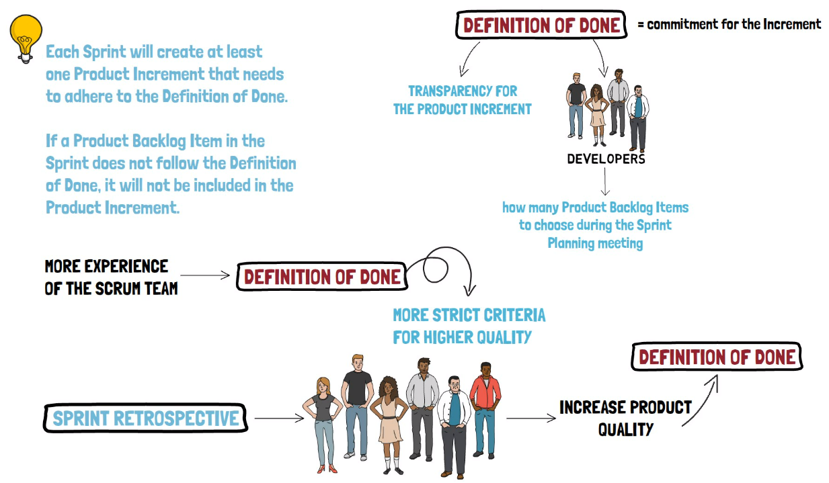
Increment & Definition of Done

Slide 29
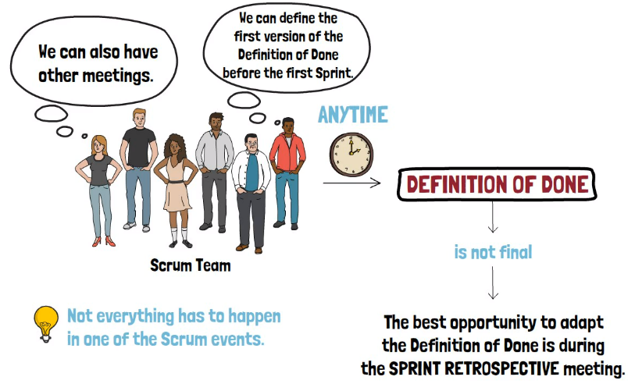
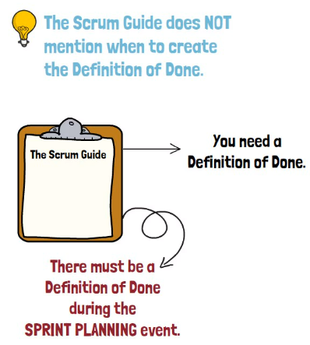
When is the Definition of Done created?
Essentially, whenever you wish.
As long as you don't break any Scrum rules. The main requirement from the Scrum Guide is that there must be a Definition of Done during the Sprint Planning event.
Often, people think that everything needs to happen in one of the Scrum events. And this is not accurate.
The Scrum Team can also have other meetings. This is not prohibited by Scrum. Nothing prevents the Scrum Team from defining the first version of the Definition of Done before the First Sprint begins.
The initial Definition of Done is not perfect or final. The Scrum Team can adopt it in the upcoming Sprint. The best opportunity to do so is at the end of the Sprint, during the Sprint Retrospective meeting.

Slide 30
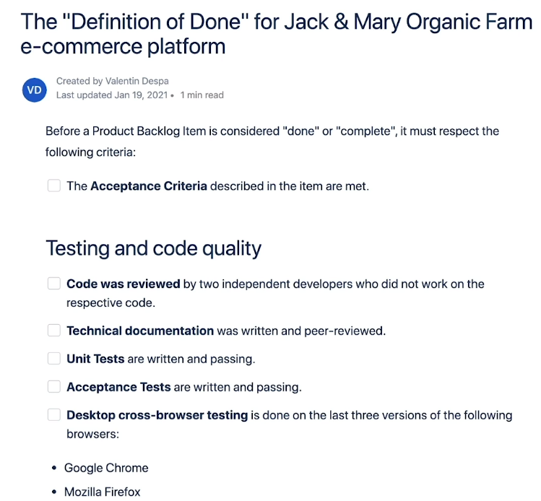
Definition of Done vs. Acceptance criteria
You can notice the definition of done is very general, makes no reference to a particular functionality.
If you go ahead and remove the title of the document, you may not even know what kind of a product this is referring to.
The definition of done tends to be more technical. Talk about
code quality,
code coverage,
security best practices,
how many code reviews are needed, and so on.

Slide 31
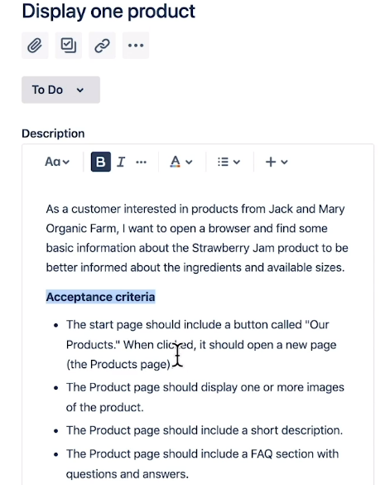
Definition of Done vs. Acceptance criteria
On the other hand, acceptance criteria are specific to a particular item.
The acceptance criteria tries to describe when an item is complete. Mostly from a functional perspective. This is a way to complement the user story.

Slide 32
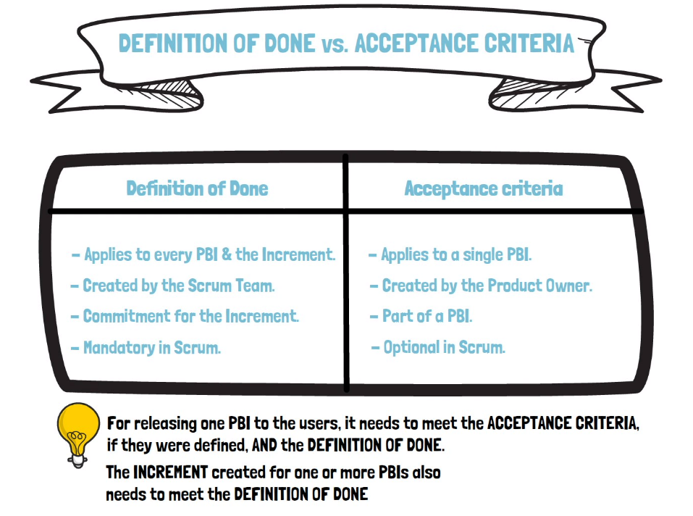

Slide 33
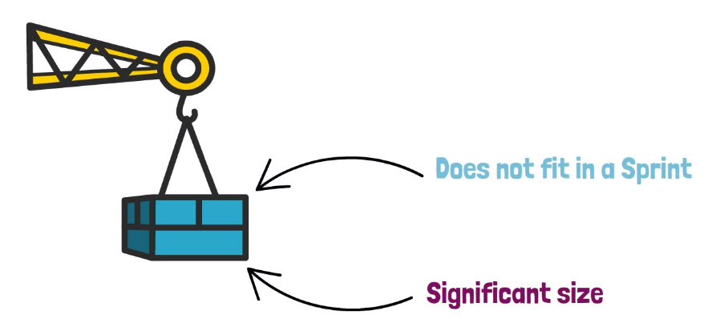
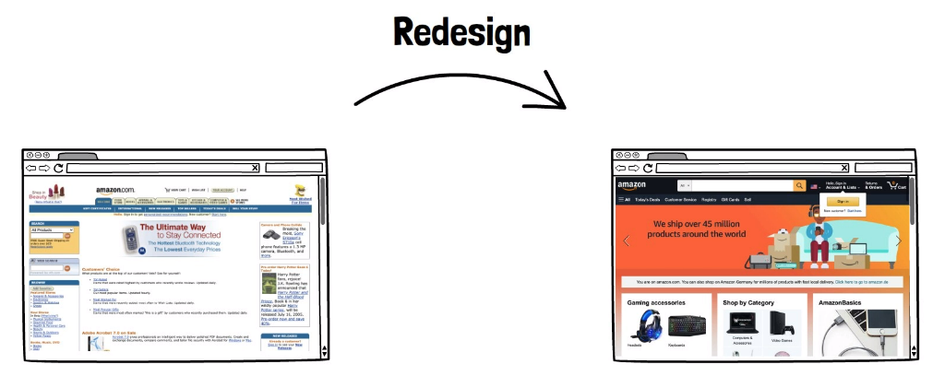
What is an epic?
An epic is some large body of work that we want to do.
As the name may suggest, it is significant in size and does not fit in a single sprint.
Let's imagine that amazon.com wants to do a UI redesign.
That's an epic.

Slide 34
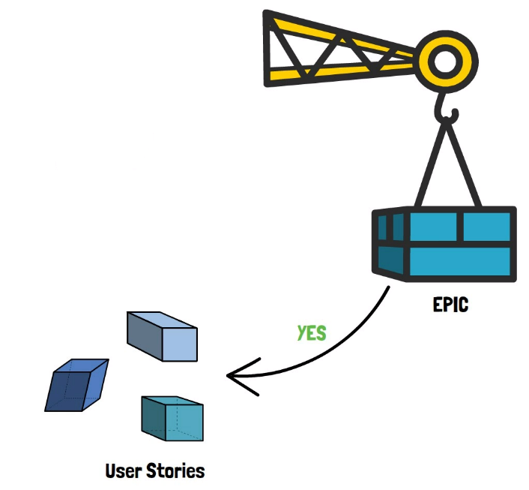
What is an epic?
By having conversations with the developers, a product owner can get early feedback and understand if a particular feature is an epic.
Meaning, it is really big, and we need a few sprints to do it, or just a regular story that can be done in a sprint without much effort.
Since we can't pull an epic into a sprint, what we want to do is to break it down into multiple user stories.

Slide 35
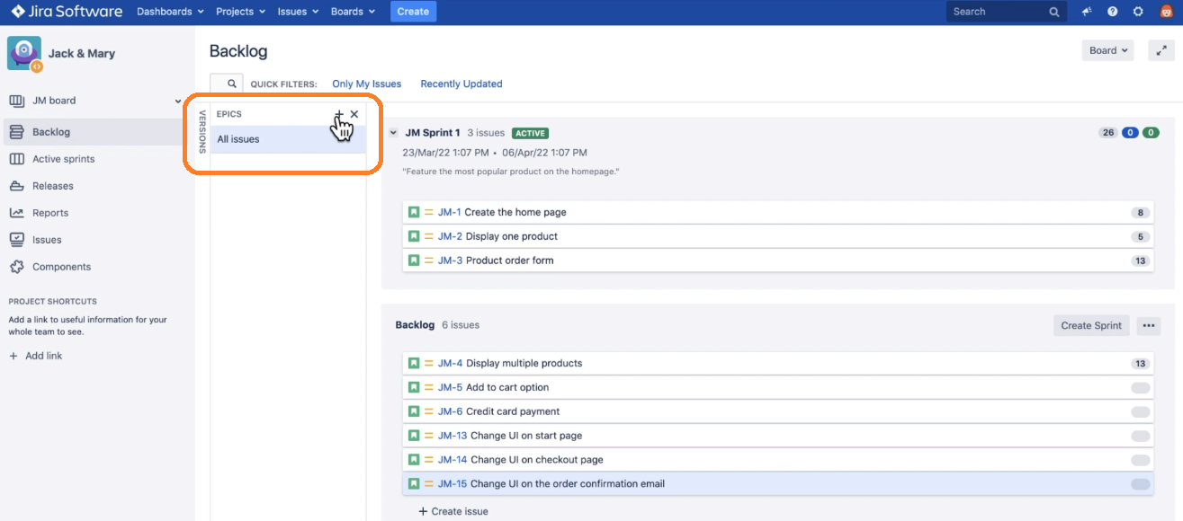
What is an epic?
In Jira, there are multiple ways to create an epic.
From the backlog view, you can simply enable the epics view, and by clicking the plus sign create an epic.

Slide 36
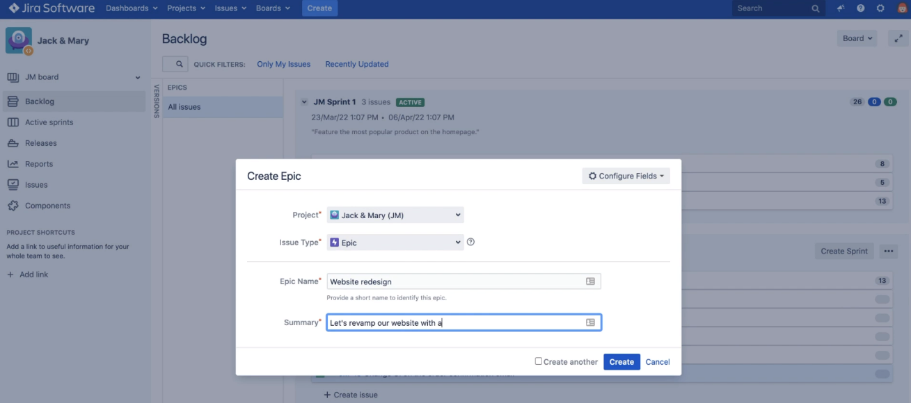
What is an epic?
Give it a name and provide a short description.

